Slide 1
NORMALIZATION

Slide 2
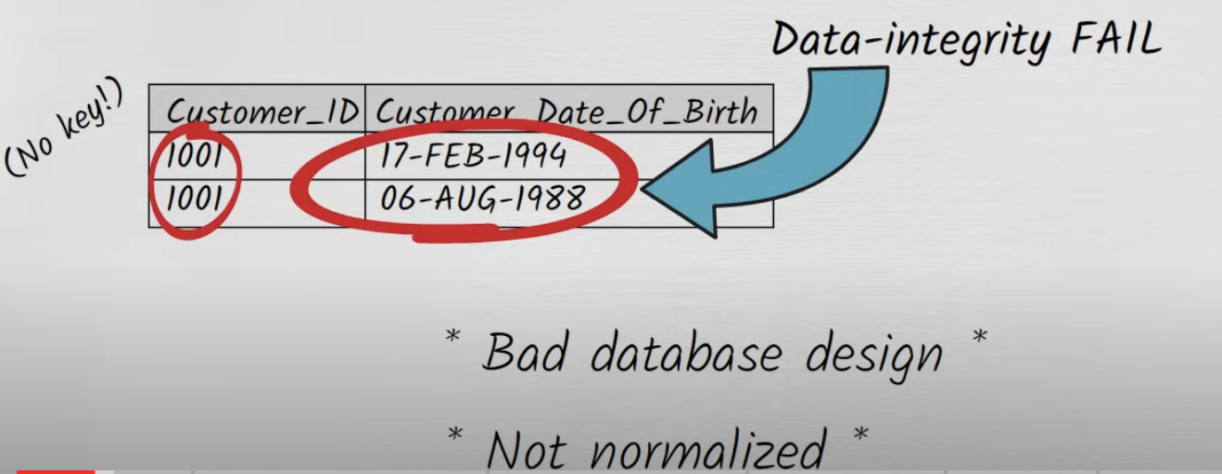
Objective
Normalization presents a set of rules that tables and databases must follow to be well structured.
Historically presented as a sequence of normal forms

Slide 3
First Normal From
A table is in the first normal form iff
  The domain of each attribute contains only atomic values, and
  The value of each attribute contains only a single value from that domain.
In layman's terms. it means every column of
your table should only contain single values

Slide 4
Example
For a library
Patron ID | Borrowed books
C45 | B33, B44, B55
C12 | B56

Slide 5
1-NF Solution
Patron ID | Borrowed book
C45 | B33
C45 | B44
C45 | B33
C12 | B56

Slide 6
Example
For an airline
Flight | Weekdays
UA59 | Mo We Fr
UA73 | Mo Tu We Th Fr

Slide 7
1NF Solution
Flight | Weekday
UA59 | Mo
UA59 | We
UA59 | Fr
UA73 | Mo
UA73 | We
… | …

Slide 8
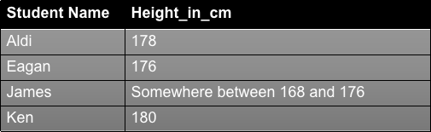
Mixed Data type
Student_Height

Slide 9
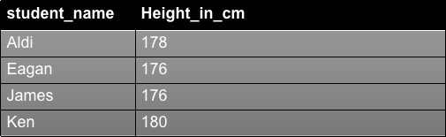
1NF Solution
We should make student_name the primary Key
Alter Table beatle_height add primary key (student_name)

Slide 10
Implication for the ER model
Watch for entities that can have multiple values for the same attribute
  Phone numbers, …
What about course schedules?
  MW 5:30-7:00pm
    Can treat them as atomic time slots

Slide 11
Functional dependency
Let X and Y be sets of attributes in a table T
Y is functionally dependent on X in T iff for each set x ∈ R. X there is precisely one corresponding set y∈ R.Y
Y is fully functional dependent on X in T if Y is functional dependent on X and Y is not functional dependent on any proper subset of X

Slide 12

Example Scenario
Imagine a school database
Functional Dependency
Functional dependency means that one attribute (or a set of attributes) uniquely determines another attribute.
StudentID -> StudentName
- No two rows have the same StudentID but different StudentNames.
Full functional dependency There can't be any attribute in the left that you can remove without losing the dependency.
(StudentID, CourseID) -> Grade
- You need both the student's ID and the course ID to determine the grade. Knowing just the StudentID or just the CourseID isn't enough.

Slide 13
Example
Book table
BookNo | Title | Author | Year
B1 | Moby Dick | H. Melville | 1851
B2 | Lincoln | G. Vidal | 1984
Author attribute is:
functionally dependent on the pair
{ BookNo, Title}
fully functionally dependent on BookNo

Slide 14
Why it matters
table BorrowedBooks
BookNo | Patron | Address | Due
B1 | J. Fisher | 101 Main Street | 3/2/15
B2 | L. Perez | 202 Market Street | 2/28/15
Address attribute is
functionally dependent on the pair
{ BookNo, Patron}
fully functionally dependent on Patron

Slide 15
Problems
Cannot insert new patrons in the system until they have borrowed books
  Insertion anomaly
Must update all rows involving a given patron if he or she moves.
  Update anomaly
Will lose information about patrons that have returned all the books they have borrowed
  Deletion anomaly

Slide 16
Armstrong inference rules (1974)
Axioms:
  Reflexivity: if Y⊆X, then X→Y
  Augmentation: if X→Y, then WX→WY
  Transitivity: if X→Y and Y→Z, then X→Z
Derived Rules:
  Union: if X→Y and X→Z, the X→YZ
  Decomposition: if X→YZ, then X→Y and X→Z
  Pseudotransitivity: if X→Y and WY→Z, then XW→Z

Slide 17
Armstrong inference rules (1974)
Axioms are both
  Sound:
  when applied to a set of functional dependencies they only produce dependency tables that belong to the transitive closure of that set
  Complete:
  can produce all dependency tables that belong to the transitive closure of the set

Slide 18
Armstrong inference rules (1974)
Three last rules can be derived from the first three (the axioms)
Let us look at the union rule:
if X→Y and X→Z, the X→YZ
Using the first three axioms, we have:
  if X→Y, then XX→XY same as X→XY (2nd)
  if X→Z, then YX→YZ same as XY→YZ (2nd)
  if X→XY and XY→YZ, then X→YZ (3rd)

Slide 19
Second Normal Form
A table is in 2NF iff
  It is in 1NF and
  no non-prime attribute is dependent on any proper subset of any candidate key of the table
A non-prime attribute of a table is an attribute that is not a part of any candidate key of the table
A candidate key is a minimal superkey

Slide 20
Example
Library allows patrons to request books that are currently out
BookNo | Patron | PhoneNo
B3 | J. Fisher | 555-1234
B2 | J. Fisher | 555-1234
B2 | M. Amer | 555-4321

Slide 21
Example
Candidate key is {BookNo, Patron}
We have
  Patron → PhoneNo
Table is not 2NF
  Potential for
    Insertion anomalies
    Update anomalies
    Deletion anomalies

Slide 22
2NF Solution
Put telephone number in separate Patron table
BookNo | Patron
B3 | J. Fisher
B2 | J. Fisher
B2 | M. Amer
Patron | PhoneNo
J. Fisher | 555-1234
M. Amer | 555-4321

Slide 23
Third Normal Form
A table is in 3NF iff
  it is in 2NF and
  all its attributes are determined only by its candidate keys and not by any non-prime attributes

Slide 24
Example
Table BorrowedBooks
BookNo | Patron | Address | Due
B1 | J. Fisher | 101 Main Street | 3/2/15
B2 | L. Perez | 202 Market Street | 2/28/15
Candidate key is BookNo
Patron → Address

Slide 25
3NF Solution
Put address in separate Patron table
BookNo | Patron | Due
B1 | J. Fisher | 3/2/15
B2 | L. Perez | 2/28/15
Patron | Address
J. Fisher | 101 Main Street
L. Perez | 202 Market Street

Slide 26
Another example
Tournament winners
Candidate key is {Tournament, Year}
Winner →DOB
Tournament | Year | Winner | DOB
Indiana Invitational | 1998 | Al Fredrickson | 21 July 1975
Cleveland Open | 1999 | Bob Albertson | 28 Sept. 1968
Des Moines Masters | 1999 | Al Fredrickson | 21 July 1975

Slide 27
Boyce-Codd Normal Form
Stricter form of 3NF
A table T is in BCNF iff
  for every one of its non-trivial dependencies
  X → Y, X is a super key for T
Most tables that are in 3NF also are in BCNF

Slide 28
Example
Manager | Project | Branch
Alice | Alpha | Austin
Alice | Delta | Austin
Carol | Alpha | Houston
Dean | Delta | Houston
We can assume
  Manager → Branch
  {Project, Branch} → Manager

Slide 29
Example
Manager | Project | Branch
Alice | Alpha | Austin
Bob | Delta | Houston
Carol | Alpha | Houston
Alice | Delta | Austin
Not in BCNF because Manager → Branch and Manager is not a superkey
Will decomposition work?

Slide 30
A decomposition (I)
Manager | Project
Alice | Alpha
Bob | Delta
Carol | Alpha
Alice | Delta
Manager | Branch
Alice | Austin
Bob | Houston
Carol | Houston
Two-table solution does not preserve the dependency {Project, Branch} → Manager

Slide 31
A decomposition (II)
Manager | Project
Alice | Alpha
Bob | Delta
Carol | Alpha
Alice | Delta
Dean | Delta
Manager | Branch
Alice | Austin
Bob | Houston
Carol | Houston
Dean | Houston
Cannot have two or more managers managing the same project at the same branch

Slide 32
Multivalued dependencies
Assume the column headings in a table are divided into three disjoint groupings X, Y, and Z
For a particular row, we can refer to the data beneath each group of headings as x, y, and z respectively

Slide 33
Multivalued dependencies
A multivalued dependency X =>Y occurs if
  For any x_{c} actually occurring in the table and the list of all the x_{c}yz combinations that occur
  in the table, we will find that x_{c} is associated with the same y entries regardless of z.
A trivial multivalued dependency X =>Y is one where either
    Y is a subset of X, or
    Z is empty (X ∪ Y has all column headings)

Slide 34
Fourth Normal Form
A table is in 4NF iff
  For every one of its non-trivial multivalued dependencies X => Y, X is either:
    A candidate key or
    A superset of a candidate key

Slide 35
Example from Wikipedia
Restaurant | Pizza | DeliveryArea
Pizza Milano | Thin crust | SW Houston
Pizza Milano | Thick crust | SW Houston
Pizza Firenze | Thin crust | NW Houston
Pizza Firenze | Thick crust | NW Houston
Pizza Milano | Thin crust | NW Houston
Pizza Milano | Thick crust | NW Houston

Slide 36
Discussion
The table has no non-key attributes
  Key is { Restaurant, Pizza, DeliveryArea}
Two non-trivial multivalued dependencies
  Restaurant => Pizza
  Restaurant => DeliveryArea
since each restaurant delivers the same pizzas to all its delivery areas

Slide 37
4NF Solution
Restaurant | DeliveryArea
Pizza Milano | SW Houston
Pizza Firenze | NW Houston
Pizza Milano | NW Houston
Two separate tables
Restaurant | Pizza
Pizza Milano | Thin crust
Pizza Milano | Thick crust
Pizza Firenze | Thin crust
Pizza Firenze | Thick crust

Slide 38
Join dependency
A table T is subject to a join dependency if it can always be recreated by joining multiple tables each having a subset of the attributes of T
The join dependency is said to be trivial if one of the tables in the join has all the attributes of the table T
Notation: *{ A, B, …} on T

Slide 39
Fifth normal form
A table T is said to be 5NF iff
  Every non-trivial join dependency in it is implied by its candidate keys
A join dependency *{A, B, … Z} on T is implied by the candidate key(s) of T if and only if each of A, B, …, Z is a superkey for T

Slide 40
An example
Store | Brand | Product
Circuit City | Apple | Tablets
Circuit City | Apple | Phones
Circuit City | Toshiba | Laptops
CompUSA | Apple | Laptops
Note that Circuit City sells Apple tablets and phones but only Toshiba laptops

Slide 41
A very bad decomposition
Store | Product
Circuit City | Tablets
Circuit City | Phones
Circuit City | Laptops
CompUSA | Laptops
Brand | Product
Apple | Tablets
Apple | Phones
Apple | Laptops
Toshiba | Laptops
Let see what happens when we do a natural join

Slide 42
The result of the join
Store | Brand | Product
Circuit City | Apple | Tablets
Circuit City | Apple | Phones
Circuit City | Apple | Laptops
Circuit City | Toshiba | Laptops
CompUSA | Apple | Laptops
CompUSA | Toshiba | Laptops
Introduces two spurious tuples

Slide 43
A different table
Store | Brand | Product
Circuit City | Apple | Tablets
Circuit City | Apple | Phones
Circuit City | Apple | Laptops
Circuit City | Toshiba | Laptops
CompUSA | Apple | Laptops
Assume now that any store carrying a given brand and selling a product that is made by that brand will always carry that product

Slide 44
The same decomposition
Store | Product
Circuit City | Tablets
Circuit City | Phones
Circuit City | Laptops
CompUSA | Laptops
Brand | Product
Apple | Tablets
Apple | Phones
Apple | Laptops
Toshiba | Laptops
Let see what happens when we do a natural join

Slide 45
The result of the join
Store | Brand | Product
Circuit City | Apple | Tablets
Circuit City | Apple | Phones
Circuit City | Apple | Laptops
Circuit City | Toshiba | Laptops
CompUSA | Apple | Laptops
CompUSA | Toshiba | Laptops
Still one spurious tuple

Slide 46
The right decomposition
Store | Product
Circuit City | Tablets
Circuit City | Phones
Circuit City | Laptops
CompUSA | Laptops
Brand | Product
Apple | Tablets
Apple | Phones
Apple | Laptops
Toshiba | Laptops
Store | Brand
Circuit City | Apple
Circuit City | Toshiba
CompUSA | Apple

Slide 47
Conclusion
The first "big" table was 5NF
The second table was decomposable

Slide 48
First Normal Form (1NF)
  1. Using row order to convey information is not permitted
  2. Mixing data types within the same column is not permitted
  3. Having a table without a primary key is not permitted
  4. Repeating groups are not permitted
Second Normal Form (2NF)
Each non-key attribute in the table must be dependent on the entire primary key.
Third Normal Form (3NF)
Each non-key attribute in the table must depende on the key, the whole key, and nothing but the key.
Boyce-Codd Normal Form (BCNF)
Each attribute in the table must depend on the key, the whole key, and nothing but the key.
Fourth Normal Form (4NF)
The only kinds of multivalued dependency allowed in a table are multivalued dependencies on the key
Fifth Normal Form (5NF)
It must not possible to describe the table as being the logical result of joining some other tables together.

Slide 49
Lossless
Decomposition

Slide 50
General Concept
If R(A, B, C) satisfies A→B
  We can project it on A,B and A,C
  without losing information
  Lossless decomposition
R = π_{AB}(R) ⋈ π_{AC}(R)
  π_{AB}(R) is the projection of R on AB
  ⋈ is the natural join operator

Slide 51
Example
R
Course | Instructor | Text
4330 | Paris | none
4330 | Cheng | none
3330 | Hillford | Patterson & Hennessy
Observe that Course → Text

Slide 52
A lossless decomposition
Course | Text
4330 | none
3330 | Patterson & Hennessy
π_{Course, Text} (R)
Course | Instructor
4330 | Paris
4330 | Cheng
3330 | Hillford
π_{Course, Instructor} (R)

Slide 53
A different case
R
Course | Instructor | Text
4330 | Paris | Silberschatz and Peterson
4330 | Cheng | none
3330 | Hillford | Patterson & Hennessy
Now Course → Text
R cannot be decomposed

Slide 54
A lossy decomposition
Course | Text
4330 | none
4330 | Silberschatz & Peterson
3330 | Patterson & Hennessy
π_{Course, Text} (R)
Course | Instructor
4330 | Paris
4330 | Cheng
3330 | Hillford
π_{Course, Instructor} (R)

Slide 55
An Example

Slide 56
Normalisation Example
We have a table representing orders in an online store
Each row represents an item on a particular order
Primary key is
{Order, Product}
Columns
  Order
  Product
  Quantity
  UnitPrice
  Customer
  Address

Slide 57
Functional Dependencies
Each order is for a single customer:
  Order → Customer
Each customer has a single address
  Customer → Address
Each product has a single price
  Product → UnitPrice
As Order → Customer and Customer → Address
  Order → Address

Slide 58
2NF Solution (I)
First decomposition
  First table
  Second table
Order | Product | Quantity | UnitPrice
Order | Customer | Address

Slide 59
2NF Solution (II)
Second decomposition
  First table
  Second table
  Third table
Order | Product | Quantity
Order | Customer | Address
Product | UnitPrice

Slide 60
3NF
In second table
  Customer → Address
Split second table into
Order | Customer | Address
Order | Customer
Customer | Address

Slide 61
Normalisation to 2NF
Second normal form means no partial dependencies on candidate keys
  {Order} → {Customer, Address}
  {Product} → {UnitPrice}
To remove the first FD we project over
  {Order, Customer, Address} (R1)
and
{Order, Product, Quantity, UnitPrice} (R2)

Slide 62
Normalisation to 2NF
R1 is now in 2NF, but there is still a partial FD in R2
  {Product} → {UnitPrice}
To remove this we project over
{Product, UnitPrice} (R3)
and
{Order, Product, Quantity} (R4)

Slide 63
Normalisation to 3NF
R has now been split into 3 relations - R1, R3, and R4
  R3 and R4 are in 3NF
  R1 has a transitive FD on its key
To remove
  {Order} → {Customer} → {Address}
we project R1 over
  {Order, Customer}
  {Customer, Address}

Slide 64
Normalisation
1NF:
  {Order, Product, Customer, Address, Quantity, UnitPrice}
2NF:
  {Order, Customer, Address}, {Product, UnitPrice}, and {Order, Product, Quantity}
3NF:
  {Product, UnitPrice}, {Order, Product, Quantity},
  {Order, Customer}, and {Customer, Address}

